Slide 1




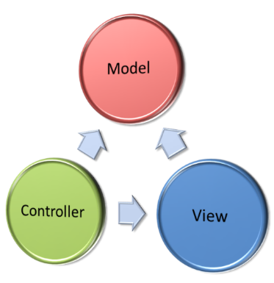
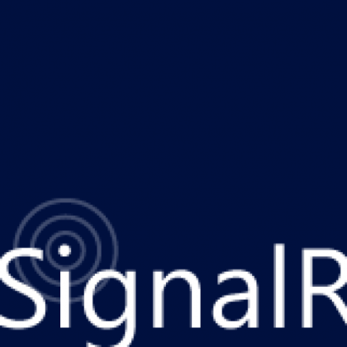
ASP.NET SignalR
SoftUni Team
Technical Trainers
Software University
http://softuni.bg

Slide 2


Table of Contents
Web-based real-time communication
Problems and solutions
ASP.NET SignalR - Overview & concepts
Hubs
Server-side API
Clients
Client-side API
Chat Live Demo

Slide 3

Web based real-time communication
Now, now and now!

Slide 4
Problems & Solutions
Users want data
Now & instant
Up-to-date
Delivered to any device, over any connection
Examples
Live searches/updates
Stock streamers, auctions
Live scores, betting, interactive games
Real-time feedback, real-time notifications

Slide 5
Problems & Solutions
Developers need to provide real time data
But not only for web applications
What about mobile devices & apps?
What about traditional desktop applications?
What about server-to-server?
Push communication beyond the web is a need
Think, design & implement Push Services

Slide 6

Push Services Pattern
Not official of course!

Slide 7
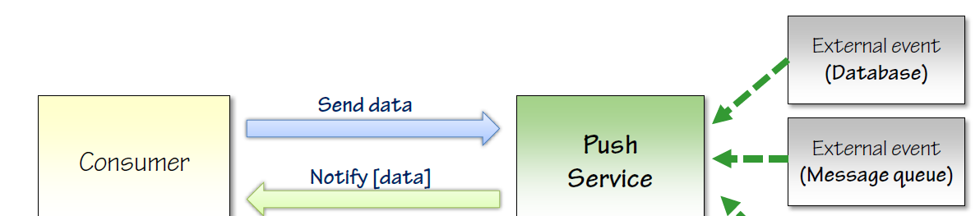
Push Services Pattern
Push Services are not an official pattern
Model a service that
accepts incoming connections from callers
is able to push data down to callers
abstracts from communication only details

Slide 8
HTTP Protocol
Web communication – HTTP!
Basically request-response
Realize Push services with HTTP
Periodic Polling
Long Polling
Forever Frame
Server-Sent Events (SSE)
Web Sockets
http://tinyurl.com/push-services

Slide 9
Web Sockets
Web Sockets – latest piece of technology!
Positives:
Easy
Constant connection
Send only small details
Negatives
Only with Windows 8/Server 2012
Network considerations
Maybe some time, but not today

Slide 10
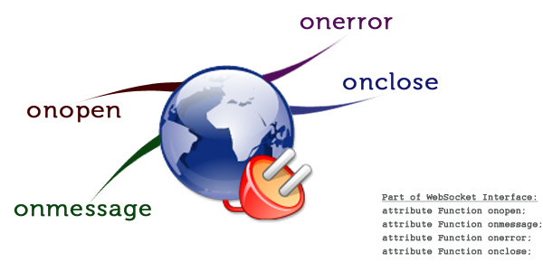
Web Sockets
Live Demo

Slide 11
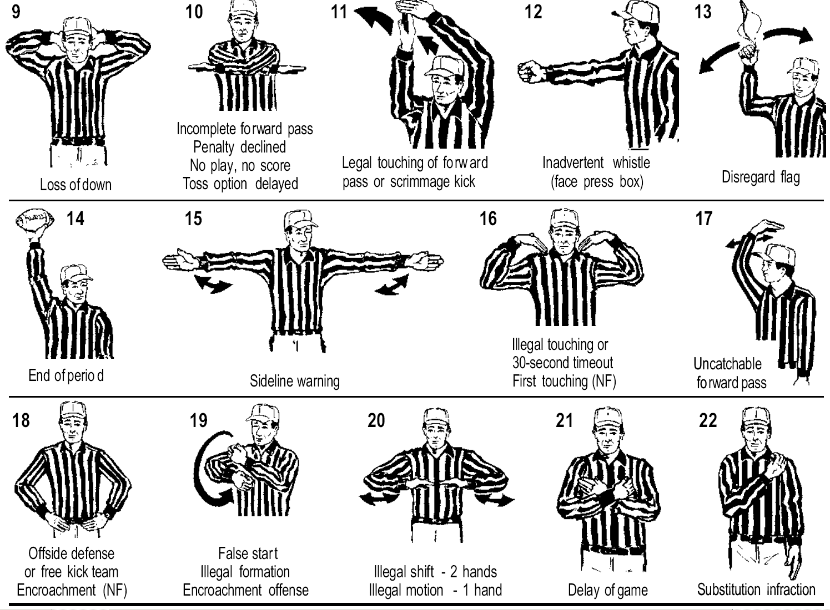
SignalR Solution
Part of ASP.NET but not tied to it!

Slide 12
SignalR
SignalR is:
A server-side framework to write push services
Clients for easy communication on any device
Optimized for asynchronous operations
Operation:
Persistent connection
Data is sent as signal through connection ID
Volatile

Slide 13
SignalR
Framework is based on Interfaces:
Programming modes:
Persistent connection
Hubs
Hubs offer predefined API for most scenarios
SignalR example:
http://shootr.signalr.net/

Slide 14
SignalR
Packages at NuGet:
Microsoft.AspNet.SignalR
Microsoft.AspNet.SignalR.Core
Microsoft.AspNet.SignalR.Owin
Microsoft.AspNet.SignalR.Js
Microsoft.AspNet.SignalR.Client
Microsoft.AspNet.SignalR.Utils

Slide 15
SignalR
Installation
Download Microsoft.AspNet.SignalR
In Startup.cs file map the SignalR
Create directory Hubs
Add new SignalR classes to it
Done!
public void Configuration(IAppBuilder app)
{
app.MapSignalR();
}

Slide 16
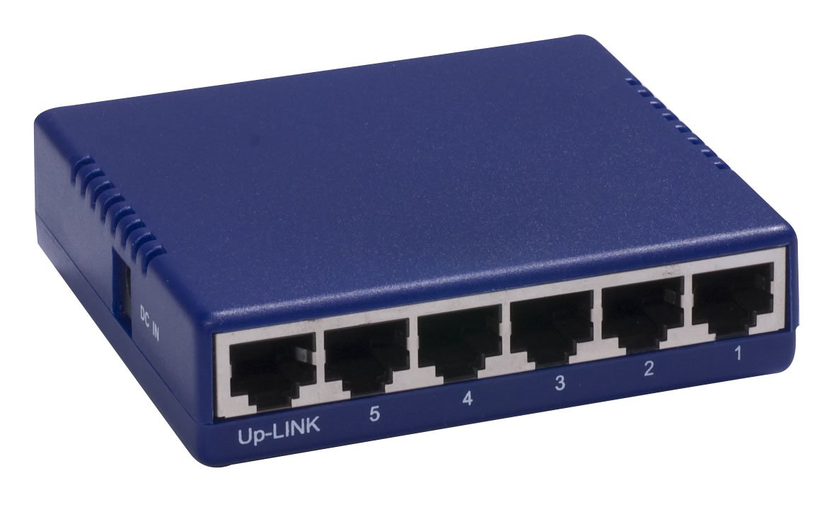
SignalR Hubs
Server-side

Slide 17
Hubs
Classes to implement push services
Abstraction on top of persistent connection
Convention over configuration
Perfect for sending data from server to clients
Conventions
Public methods are callable from clients
Send data by invoking client methods

Slide 18
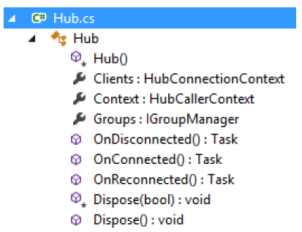
Hub Programming
Hub name reflected onto external API
Return simple type, complex type or Task
Objects and collection – automatically to JSON
Context
ConnectionId
Request
Headers
RequestCookies
QueryString
User

Slide 19
Hub Programming
Base endpoint is /signalr
JS metadata from /signalr/hubs
Basically two protocol steps
negotiate: which transport do you support?
connect: OK, here is my persistent connection
‘Best’ transport negotiation
W. Sockets -> SSE -> Forever frame -> L. polling
Any data is JSON encoded

Slide 20
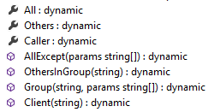
Clients Property
Clients property to send messages to clients
Holds dynamic properties and methods
Target method with parameters
Dynamically ‘injected’
Serialized
Embedded into response
public void SendMessage(string message)
{
var msg = string.Format("{0}: {1}",
Context.ConnectionId, message);
Clients.All.newMessage(msg);
}

Slide 21
Groups Property
Groups - typical base pattern in push scenarios
Add connections to groups
And send messages to particular groups
Groups are not persisted on server!
public void JoinRoom(string room)
{
Groups.Add(Context.ConnectionId, room);
}
public void SendToRoom(string room, string message)
{
var msg = string.Format("{0}: {1}", Context.ConnectionId, message);
Clients.Group(room).newMessage(msg);
}

Slide 22
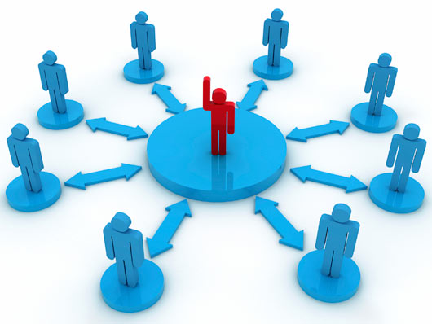
SignalR Clients
Client-side

Slide 23

Clients
Consumers
Client applications
Other services/hubs
SignalR provides a variety of client libraries
WinRT
Windows Phone 8
Silverlight 5
jQuery
C++

Slide 24
jQuery Client
Automatic proxy code via /signalr/hubs
Script generated based on hubs declaration
Hubs become properties on $.connection
Example $.connection.chatHub
Hub name camel cased
$.connection.hub.start() – start connection
$.connection.hub.start({ transport: 'longPolling'});
var chat = $.connection.chat;
chat.server.joinRoom('private');

Slide 25
jQuery Client
Define client side methods
They can be invoked by the hub
Events for connection state handling
Detect slow connections
Cross-domain support
var chat = $.connection.chat;
chat.client.newMessage = onNewMessage;
function onNewMessage(message) {
$('#messages').append(message);
}

Slide 26

Chat
Live Demo

Slide 27









ASP.NET MVC
https://softuni.bg/courses/asp-net-mvc/

Slide 28
License
This course (slides, examples, demos, videos, homework, etc.) is licensed under the "Creative Commons Attribution-NonCommercial-ShareAlike 4.0 International" license
Attribution: this work may contain portions from
"ASP.NET MVC" course by Telerik Academy under CC-BY-NC-SA license

Slide 29





Free Trainings @ Software University
Software University Foundation – softuni.org
Software University – High-Quality Education, Profession and Job for Software Developers
softuni.bg
Software University @ Facebook
facebook.com/SoftwareUniversity
Software University @ YouTube
youtube.com/SoftwareUniversity
Software University Forums – forum.softuni.bg

